Slide 1
Clustering III
Slides taken from
cs-people.bu.edu/evimaria/cs565/lect6.ppt

Slide 2
Expectation-maximization algorithm
Iterative procedure to compute the Maximum Likelihood (ML) estimate – even in the presence of missing or hidden data
EM consists of two steps:
  Expectation step: the (missing) data are estimated given the observed data and current estimates of model parameters
  Maximization step: The likelihood function is maximized under the assumption that the (missing) data are known

Slide 3
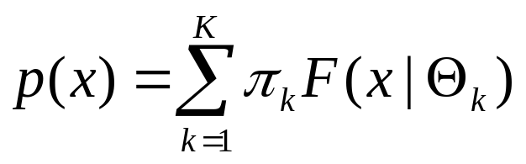
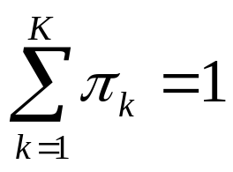
EM algorithm for mixture of Gaussians
What is a mixture of K Gaussians?
with
and F(x|Θ) is the Gaussian distribution with parameters Θ = {μ,Σ}

Slide 4
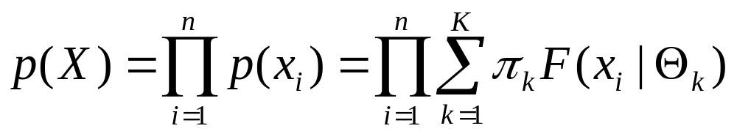
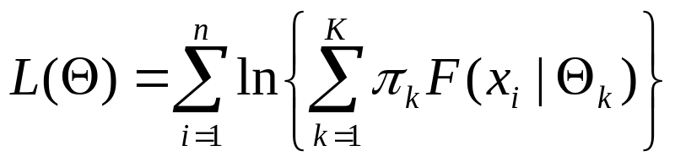
EM algorithm for mixture of Gaussians
If all points xєX are mixtures of K Gaussians then
Goal: Find π₁,…, π_{k} and Θ₁,…, Θ_{k} such that P(X) is maximized
Or, ln(P(X)) is maximized:

Slide 5
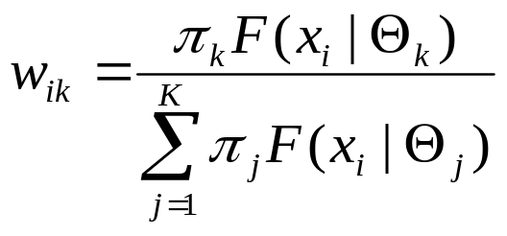
Mixtures of Gaussians -- notes
Every point x_{i} is probabilistically assigned (generated) to (by) the k-th Gaussian
Probability that point x_{i} is generated by the k-th Gaussian is

Slide 6
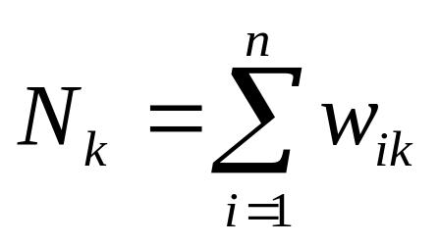
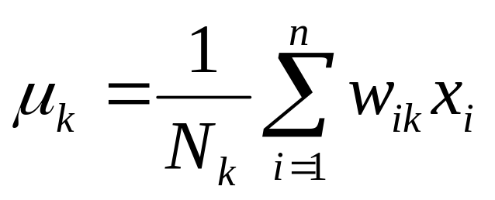
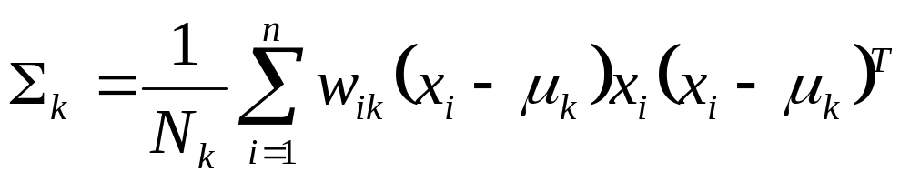
Mixtures of Gaussians -- notes
Every Gaussian (cluster) C_{k} has an effective number of points assigned to it N_{k}
With mean
And variance

Slide 7
EM for Gaussian Mixtures
Initialize the means μ_{k}, variances Σ_{k} (Θ_{k}=(μ_{k},Σ_{k})) and mixing coefficients π_{k}, and evaluate the initial value of the loglikelihood
Expectation step: Evaluate weights

Slide 8
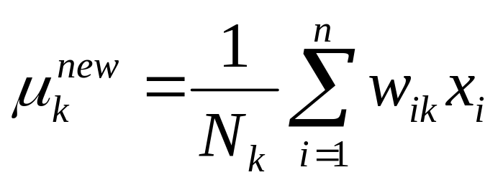
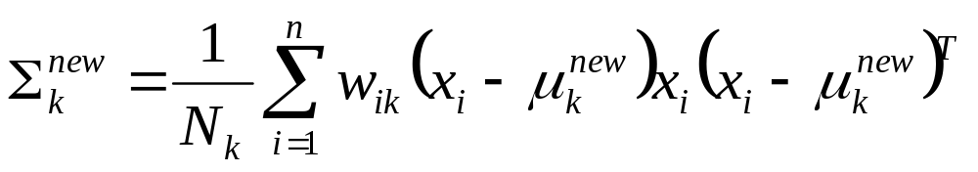
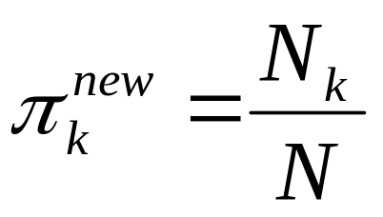
EM for Gaussian Mixtures
Maximization step: Re-evaluate parameters
Evaluate L(Θ^{new}) and stop if converged

